Slide 1
guizero button examples
Using buttons to control outputs

Slide 2
Button Tracker
This example can be used to make the push buttons act like an on/off button.
It uses a boolean variable to track if the button is on or off, it also has a Text showing on or off.
See the guizero page for available colors.
#d9d9d9 is the hex code for the default grey
This would be useful if you wanted to control more than one thing with one button. For example, control the color of the button and turn on/off an led or motor

Slide 3
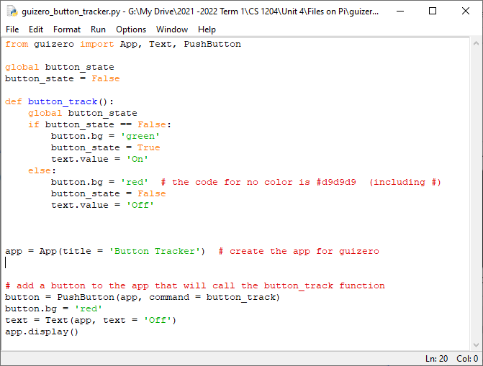
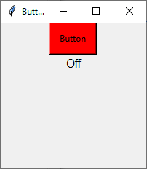
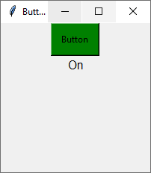

Slide 4
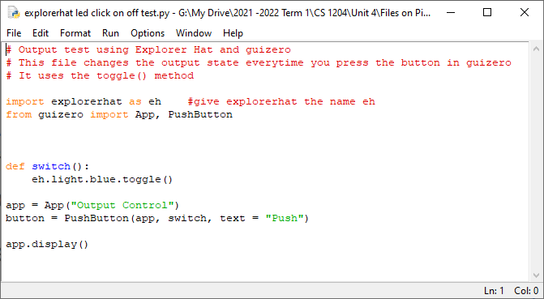
Toggle Output
If you just want to control turn on or off an output then you can use the toggle method. Every time you click the button the output will toggle between on and off. This will work for the built in leds or the outputs.

Slide 5
On while held
Sometimes it may be useful to only have an output device on while you hold a button down. It uses the repeat() method to call a function over and over again.
Note*
This method is causing some issues with the motor outputs for some people.

Slide 6
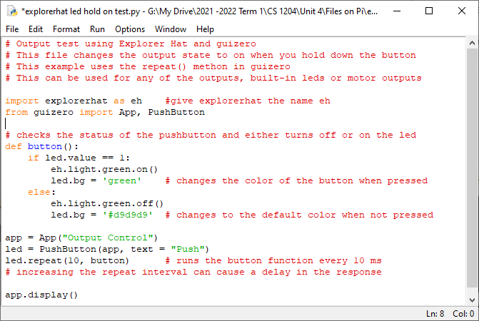

Slide 7
You should try the items listed in the Things to Try doc posted in our google classroom, or come up with something else that you want to do.
Check the explorer hat function reference for more information about what you can do.
https://github.com/pimoroni/explorer-hat/blob/master/documentation/Function-reference.md

